Slide 1
Globally Optimal Feedback Control Law of the Underactuated Heisenberg System by Generating Functions
Chan Park, Daniel J. Scheeres
Dept. of Aerospace Eng., Univ. of Michigan, Ann Arbor, MI
Anthony M. Bloch
Dept. of Mathematics, Univ. of Michigan, Ann Arbor, MI
Vincent M. Guibout
Advanced Concepts Dept., MBDA, France

Slide 2
Table of Contents
Introduction
Problem Statement & Formulation
Optimal Feedback Control Law by Generating Functions
Qualitative Analysis
Numerical Illustration
Conclusions & Future Work

Slide 3
Scope & Our Approach
Deterministic
Finite Horizon
Optimal Feedback Control (OFC) Problem
Underactuated Heisenberg System
Potential Applicability to General Underactuated System
Hamiltonian System Theory
Two Point Boundary Value Problem (TPBVP)
Canonical Transformation
Generic Procedure using Generating Functions

Slide 4
Traditional Techniques & Current Status
Hamilton-Jacobi-Bellman (HJB) Equation
  ➔ For General Boundary Conditions (BCs)
Generalized Hamilton-Jacobi-Bellman Equation
1st Order Necessary Conditions for Optimality
State-Dependent Ricatti Equation
Use of Special Canonical Transformations
  ➔ For Limited Types of Boundary Conditions
Analytical Derivation by Beals et al. (2000)
from Subelliptic Geometry of Heisenberg Groups

Slide 5
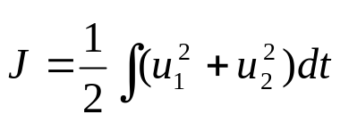
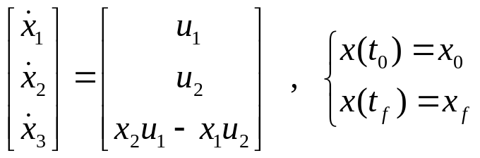
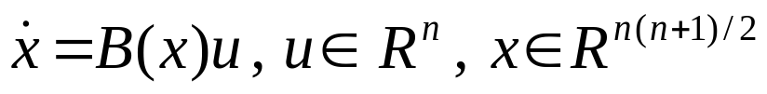
Problem Statement
Minimize
subject to
Underactuated System
  → Third Component is actuated through Coupling
  →Axisymmetric Nature
  →Analytical Restraints
Canonical System for a class of Controllable System

Slide 6
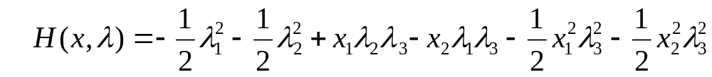
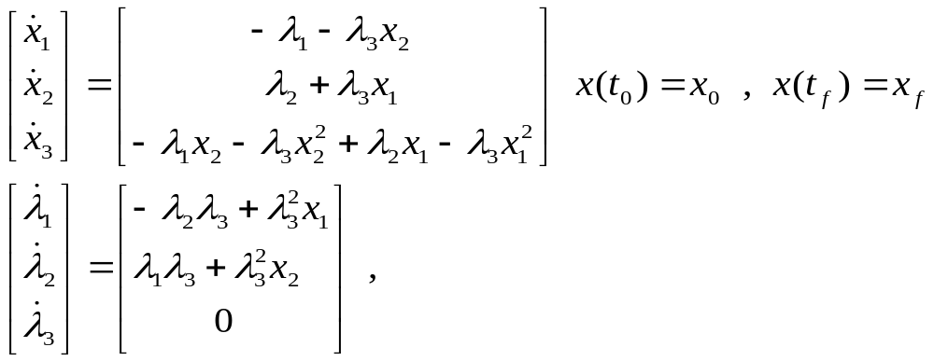
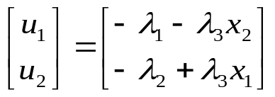

TPBVP for Hamiltonian System
Standard Hamiltonian System derived from
the 1st order Necessary Conditions for Optimality
Determination of is Pivotal.

Slide 7
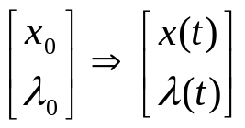
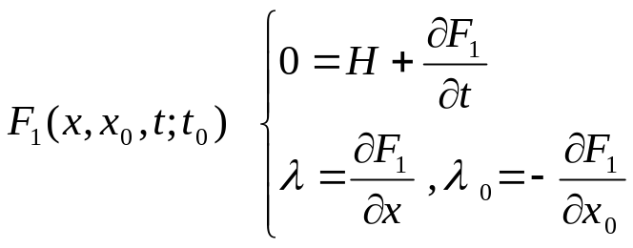
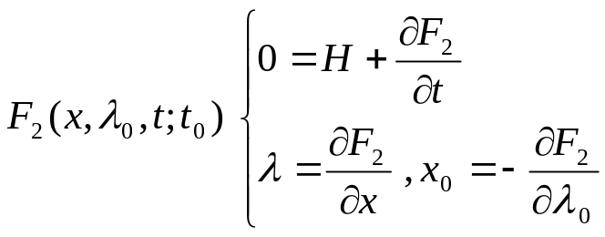




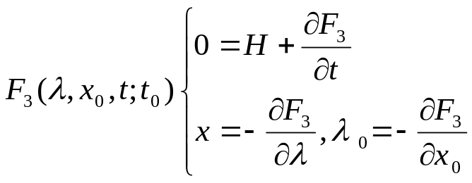

TPBVP Viewed as Canonical Transformation
Mapping is a Canonical Transformation.
A Set of Generating Functions Defined for Itself
  Solutions to Hamilton-Jacobi Equations.
  Algebraically Connected by Legendre transformations

Slide 8

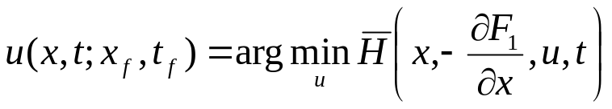

Sufficient Condition for Optimality
THEOREM: For the given TPBVP,
is the Optimal Cost Function.
The OFC Law can be represented as
NOT just a Restatement of HJB Sufficient Condition
  is Algebraically Reconfigurable to Different Types of Boundary Conditions (Unlike Solutions to HJB Equation)
  Legendre Transformation Provides Flexibility of Analysis
  Some Generating Functions are Easier to Solve than Others

Slide 9
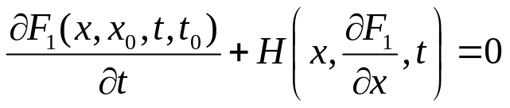



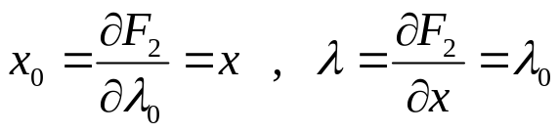
How to Compute the F₁: Technical difficulty
Solution to the Hamilton-Jacobi Equation
  Same Type of the HJB Equation
  Functions of 2n Spatial Variables
Need at least One Initial/Boundary Conditions
  The Only Clue comes from the Identity Transformation
  is Inherently Singular
  realizes this Identity Transformation

Slide 10


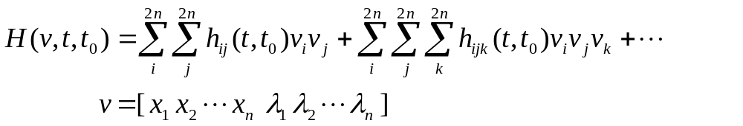
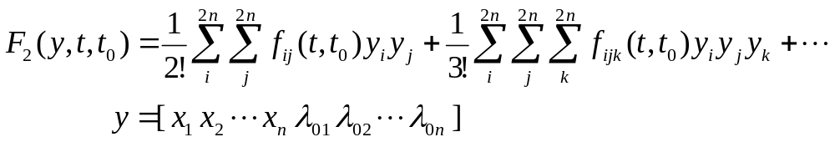
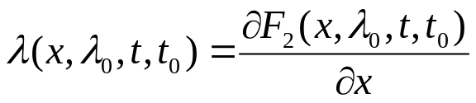
General Procedure to Compute F₁
Based on Guibout & Scheeres (03) on TPBVP
  Nominal Optimal Solution is Known or
  is Analytic
  is Controllable
Expand H & F₂ as Polynomial Series:

Slide 11
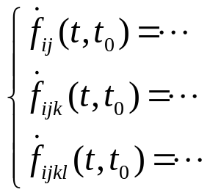
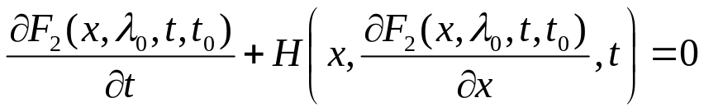
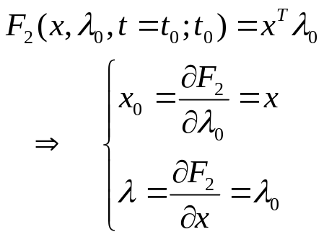
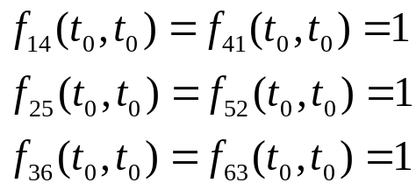
General Procedure to Compute F₁ (cont’d)
Introduce into the Hamilton-Jacobi Equation for F₂ :
Initial Conditions Derived from Identity Transformation

Slide 12

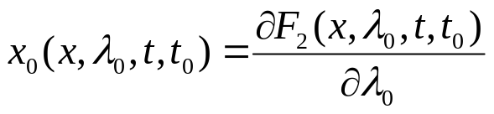
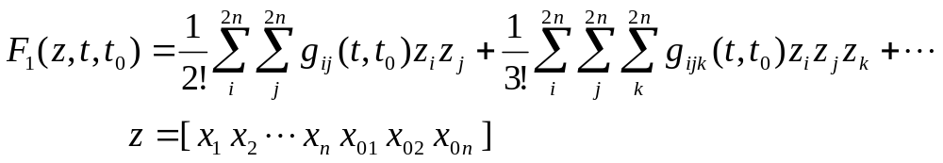
General Procedure to Compute F₁ (cont’d)
Algebraic Legendre Transformation into the F₁:
Series Inversion

Slide 13
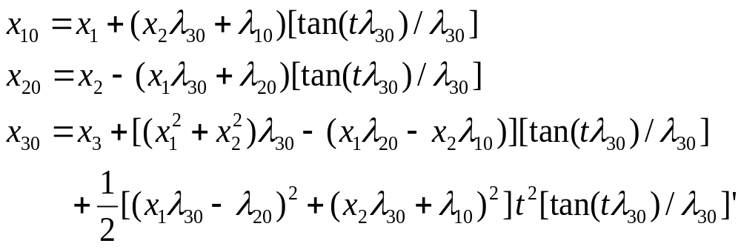
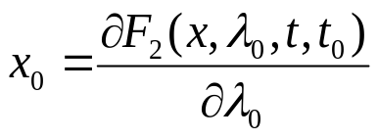
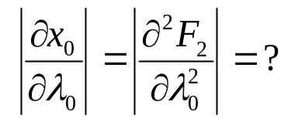
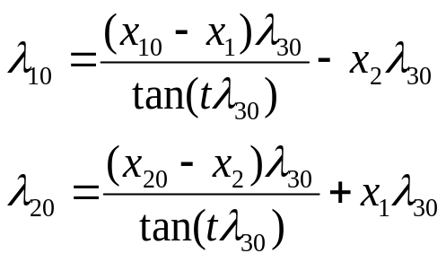
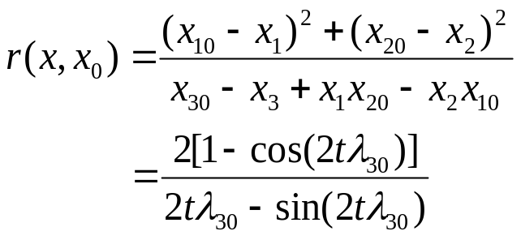
OFC Law for Heisenberg System
F₂ in Compact Analytical Form
Technical Difficulty in Series Inversion
Implicit Relation
3
1
4
2
5

Slide 14

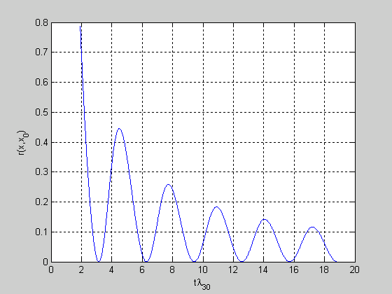



OFC Law for Heisenberg System (cont’d)
Legendre Transformation yields
Solution Characteristics
  Initial and Terminal States
  provides
provides the true optimal solution

Slide 15


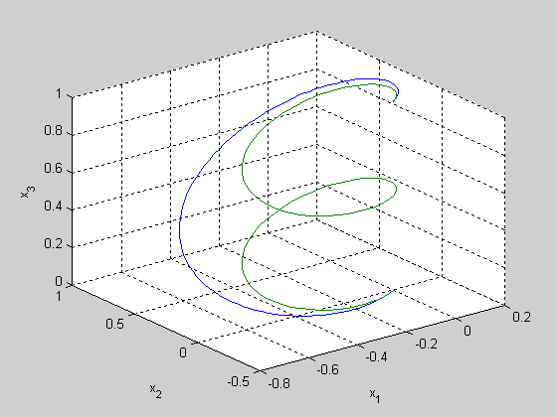

OFC Law for Heisenberg System (cont’d)
provides non-optimal solution
  NOT minimize the performance index
  NOT satisfy Jacobi no-conjugate point condition
→ Initial point on the x₃-axis
  Non-unique
  Axisymmetric
  N-spiral
  N=1 provides true solution
  satisfying Jacobi condition
→ Planar Transfer on the x₁x₂-plane

Slide 16
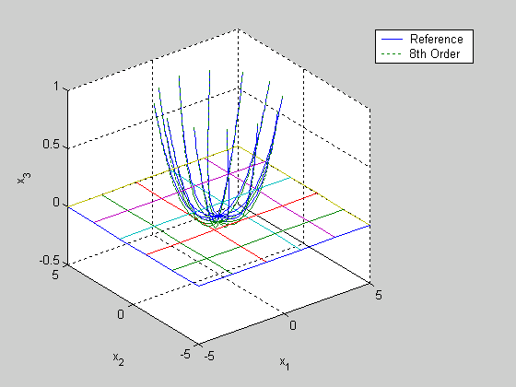
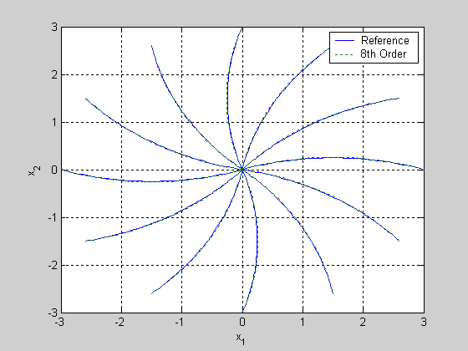
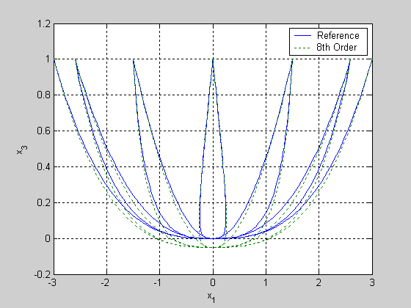
Numerical Illustration
Numerical Example 1:

Slide 17
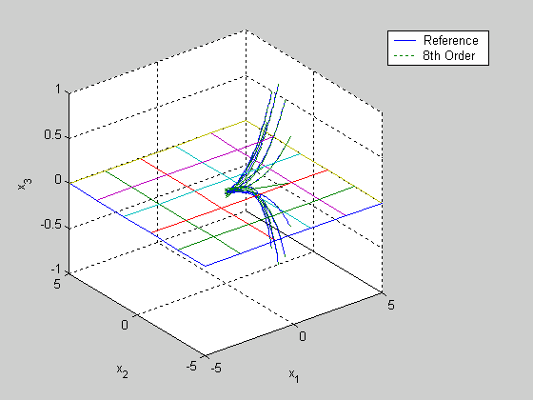
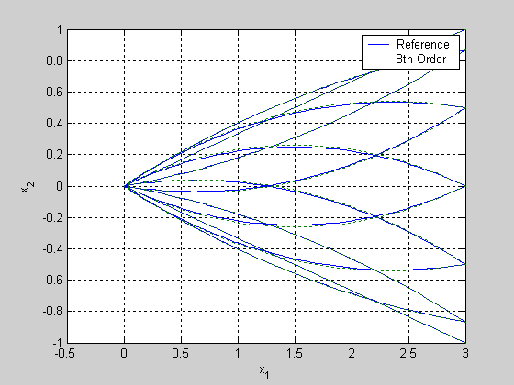
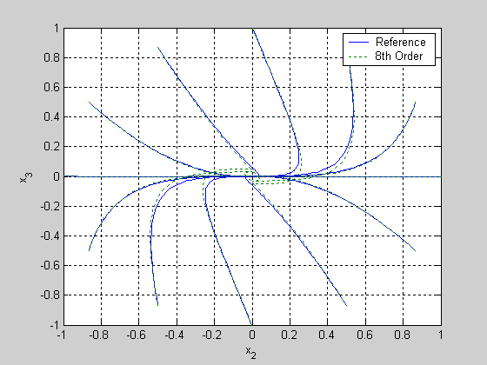
Numerical Illustration (cont’d)
Numerical Example 2:

Slide 18
Summary & Future Work
Generating Function Method successfully extended for OFC problem for Underactuated System
Provides OFC Law in Analytical Form and In-depth Analysis on Heisenberg Optimal Control System
Legendre Transformation plays a key role
Further Analysis on General Boundary Conditions
Extension into General Underactuated Systems

